Slide 1
MIS
CHAPTER 5
PROTECTING INFORMATION RESOURCES
Hossein BIDGOLI

Slide 2
Chapter 5 Protecting Information Resources
l e a r n i n g o u t c o m e s
LO1 Describe basic safeguards in computer and network security.
LO2 Explain the major security threats.
LO3 Describe security and enforcement measures.
LO4 Summarize the guidelines for a comprehensive security system, including business continuity planning.

Slide 3
Is Facebook a Friend or Fiend?
In 2010, a hacker named Kirllos was peddling 1.5 million stolen Facebook accounts for as little as 2.5 cents per account
If true, that would mean that one out of every 300 Facebook users were, unbeknownst to them, on the market
Cyber criminals use stolen accounts to spam, scam, and otherwise profit from unwary Facebook users, who are likely to respond to a familiar face or name without realizing that the friend is a fiend

Slide 4
Computer and Network Security: Basic Safeguards
Critical for most organizations
  Especially in recent years, with “hackers” becoming more numerous and adept at stealing and altering private information
Hackers use a variety of tools to break into computers and networks
  Sniffers, password crackers, and rootkits
  Journals Phrack and 2600: The Hacker Quarterly

Slide 5
Computer and Network Security: Basic Safeguards (cont’d.)
Comprehensive security system
  Protects an organization’s resources
  Including information and computer and network equipment, e-mails, invoices transferred via electronic data interchange (EDI), new product designs, marketing campaigns, and financial statements
Threats
  Include sharing passwords with coworkers, leaving a computer unattended while logged on to the network, or even spilling coffee on a keyboard

Slide 6
Computer and Network Security: Basic Safeguards (cont’d.)
Comprehensive security system
  Includes hardware, software, procedures, and personnel that collectively protect information resources
Confidentiality
  System must not allow disclosing information to anyone who isn’t authorized to access it
  Secure government agencies
  Businesses
  E-commerce

Slide 7
Computer and Network Security: Basic Safeguards (cont’d.)
Integrity
  Ensures the accuracy of information resources in an organization
  Financial transactions
Availability
  Ensures that computers and networks are operating
  Authorized users can access the information they need

Slide 8
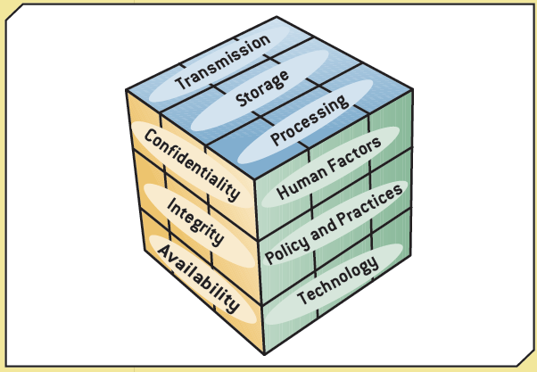
Exhibit 5.1
The McCumber Cube

Slide 9
Computer and Network Security: Basic Safeguards (cont’d.)
Three levels of security
  Level 1: front-end servers
  Level 2: back-end systems
  Level 3: corporate network
Fault-tolerant systems
  Combination of hardware and software for improving reliability
  Uninterruptible power supply (UPS)
  Redundant array of independent disks (RAID)
  Mirror disks

Slide 10
Security Threats: An Overview
Some threats can be controlled completely or partially, but some can’t be controlled
Categories
  Unintentional
  Intentional

Slide 11
Intentional Threats
Viruses
Worms
Trojan programs
Logic bombs
Backdoors
Blended threats (e.g., worm launched by Trojan)
Rootkits
Denial-of-service attacks
Social engineering

Slide 12
Viruses
Type of malware
In 2008, the number of computer viruses in existence exceeded one million
Estimating the dollar amount of damage viruses cause can be difficult
Usually given names
  I Love You, Michelangelo
Consists of self-propagating program code that’s triggered by a specified time or event

Slide 13
Viruses (cont’d.)
Seriousness of viruses varies
Transmitted through a network and e-mail attachments
  Bulletin or message boards
Virus hoaxes
  Can cause as much damage as real viruses
Indications of a computer infected by a virus
Best measure against viruses
  Installing and updating antivirus programs

Slide 14
Worms
Travel from computer to computer in a network
  Do not usually erase data
Independent programs that can spread themselves without having to be attached to a host program
Replicate into a full-blown version that eats up computing resources
Well-known worms
  Code Red, Melissa, and Sasser

Slide 15
Trojan Programs
Named after the Trojan horse the Greeks used to enter Troy during the Trojan Wars
Contains code intended to disrupt a computer, network, or Web site
Usually hidden inside a popular program

Slide 16
Logic Bombs
Type of Trojan program used to release a virus, worm, or other destructive code
Triggered at a certain time or by an event

Slide 17
Backdoors
Programming routine built into a system by its designer or programmer
Enable the designer or programmer to bypass system security and sneak back into the system later to access programs or files
System users aren’t aware a backdoor has been activated

Slide 18
Blended Threats
Combine the characteristics of computer viruses, worms, and other malicious codes with vulnerabilities found on public and private networks
Main goal is not just to start and transmit an attack, but also to spread it
Multi-layer security system could guard against blended threats

Slide 19
Denial-of-Service Attacks
Flood a network or server with service requests
  Prevent legitimate users’ access to the system
Target Internet servers
Distributed denial-of-service (DDoS) attack
  Hundreds or thousands of computers work together to bombard a Web site with thousands of requests for information in a short period
  Difficult to trace

Slide 20
Social Engineering
Using “people skills” to trick others into revealing private information
  Takes advantage of the human element of security systems
Use the private information they’ve gathered to break into servers and networks and steal data
Commonly used social-engineering techniques
  “Dumpster diving” and “shoulder surfing”

Slide 21
Protecting Against Data Theft and Data Loss
Portable storage media
  Theft or loss of media
  Stealing company data
Guidelines to protect against these risks

Slide 22
Security Measures and Enforcement: An Overview
Biometric security measures
Nonbiometric security measures
Physical security measures
Access controls
Virtual private networks
Data encryption
E-commerce transaction security measures
Computer Emergency Response Team

Slide 23
Biometric Security Measures
Use a physiological element to enhance security measures
Devices and measures
  Facial recognition
  Fingerprints
  Hand geometry
  Iris analysis
  Palmprints
  Retinal scanning
  Signature analysis
  Vein analysis
  Voice recognition

Slide 24
Biometrics at Phoebe Putney Memorial Hospital
Phoebe Putney Memorial Hospital switched to fingerprint scanners, which, along with a single sign-on application, made the electronic health record system both easier to use and more secure
Another advantage of fingerprint scanners: They don’t tend to get lost, like smart cards

Slide 25
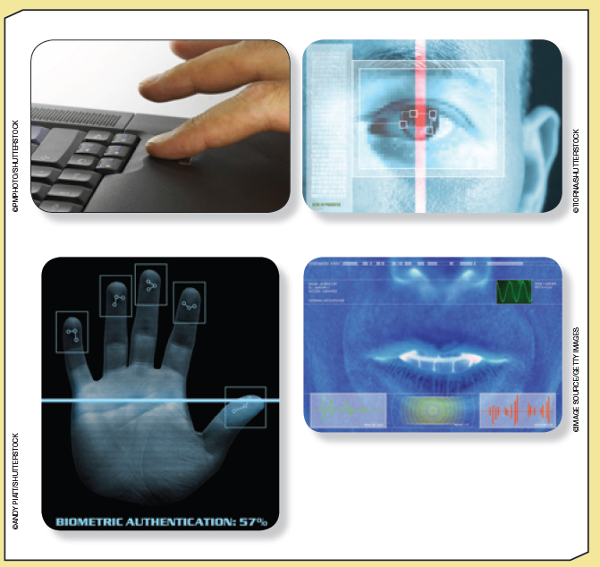
Exhibit 5.2
Examples of Biometric Devices

Slide 26
Nonbiometric Security Measures
Main security measures:
  Callback modems
  Firewalls
  Intrusion detection systems

Slide 27
Callback Modems
Verify whether a user’s access is valid by:
  Logging the user off
  Calling the user back at a predetermined number
Useful in organizations with many employees who work off-site

Slide 28
Firewalls
Combination of hardware and software
Act as a filter or barrier between a private network and external computers or networks
Network administrator defines rules for access
Examine data passing into or out of a private network
  Decide whether to allow the transmission based on users’ IDs, the transmission’s origin and destination, and the transmission’s contents

Slide 29
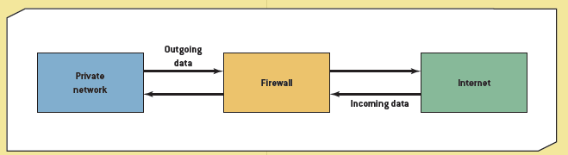
Exhibit 5.3
A Basic Firewall Configuration

Slide 30
Firewalls (cont’d.)
Possible actions after examining packet
  Reject the incoming packet
  Send a warning to the network administrator
  Send a message to the packet’s sender that the attempt failed
  Allow the packet to enter (or leave) the private network

Slide 31
Firewalls (cont’d.)
Main types of firewalls
  Packet-filtering firewalls
  Application-filtering firewalls
  Proxy servers

Slide 32
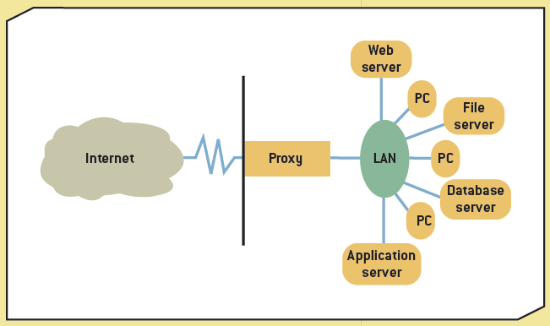
Exhibit 5.4
A Proxy Server

Slide 33
Intrusion Detection Systems
Protect against both external and internal access
Placed in front of a firewall
Prevent against DoS attacks
Monitor network traffic
“Prevent, detect, and react” approach
Require a lot of processing power and can affect network performance

Slide 34
Physical Security Measures
Primarily control access to computers and networks
Include:
  Cable shielding
  Corner bolts
  Electronic trackers
  Identification (ID) badges
  Proximity-release door openers
  Room shielding
  Steel encasements

Slide 35
Lost and Stolen Laptops
Recommendations:
  Install cable locks and use biometric measures
  Only store confidential data when necessary
  Use passwords
  Encrypt data
  Install security chips

Slide 36
Access Controls
Terminal resource security
  Software feature that erases the screen and signs the user off automatically after a specified length of inactivity
Password
  Combination of numbers, characters, and symbols that’s entered to allow access to a system
  Length and complexity determine its vulnerability to discovery
  Guidelines for strong passwords

Slide 37
Virtual Private Networks
Provide a secure “tunnel” through the Internet
  For transmitting messages and data via a private network
Remote users have a secure connection to the organization’s network
Low cost
Slow transmission speeds

Slide 38
Data Encryption
Transforms data, called “plaintext” or “cleartext,” into a scrambled form called “ciphertext”
Rules for encryption determine how simple or complex the transformation process should be
  Known as the “encryption algorithm”
Protocols:
  Secure Sockets Layer (SSL)
  Transport Layer Security (TLS)

Slide 39
Data Encryption (cont’d.)
Key size
  Between 32 and 168 bits
Main types of encryption
  Asymmetric also called “public key encryption”
  Symmetric

Slide 40
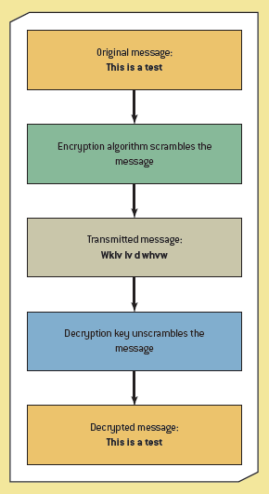
Exhibit 5.7
Using Encryption

Slide 41
E-commerce Transaction Security Measures
Three factors are critical for security:
  Authentication
  Confirmation
  Nonrepudiation
Transaction security
  Confidentiality
  Authentication
  Integrity
  Nonrepudiation of origin
  Nonrepudiation of receipt

Slide 42
Computer Emergency Response Team
Developed by the Defense Advanced Research Projects Agency
Focuses on security breaches and DoS attacks
Offers guidelines on handling and preventing these incidents
Cyber Incident Response Capability
  CIRC, http://www.doecirc.energy.gov/aboutus.html

Slide 43
Guidelines for Comprehensive Security System
Train employees
Guidelines and steps involved:
  People
  Procedures
  Equipment and technology

Slide 44
Business Continuity Planning
Outlines procedures for keeping an organization operational
Prepare for disaster
Plan steps for resuming normal operations as soon as possible

Slide 45
Summary
Types of threat
Basic safeguards
  Biometric
  Nonbiometric
Fault tolerance
Establish comprehensive security system and business continuity plan

